Slide 1
Day 5 – JavaScript Fundamental

Slide 2
Recap
For loop
While loop
Do while loop
Function
Function with parameter
Continue and Break
Default parameter
Game
DRY, YAGNI and KISS

Slide 3
Types of function in JavaScript
Named function
Anonymous function
Arrow function
Immediately invoked function expression (IIFE)
Higher Order function
Callback Function
Promise / Async-Await Function

Slide 4
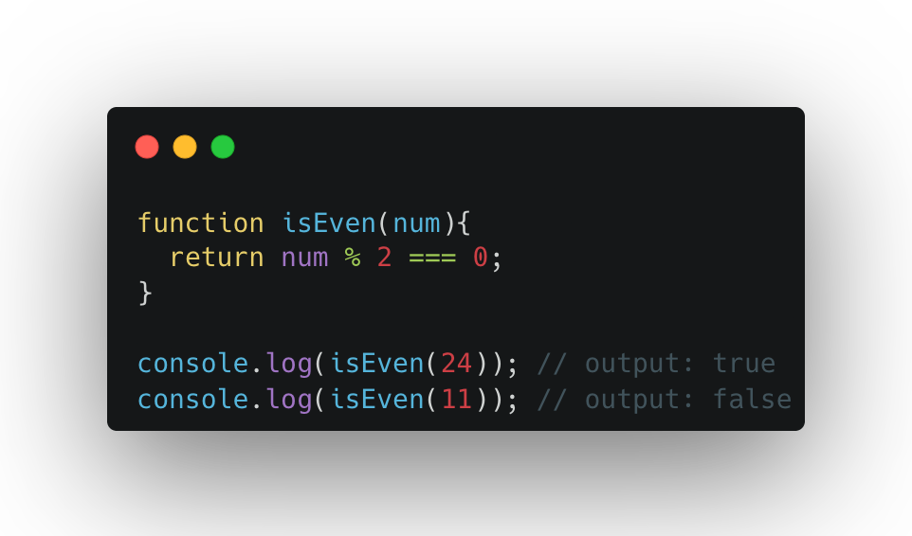
Named Function
We define it in the code and then call it whenever we need it by referencing its name and passing some arguments to it
Useful if we need to call a function many times to pass different values to it or run it several times

Slide 5
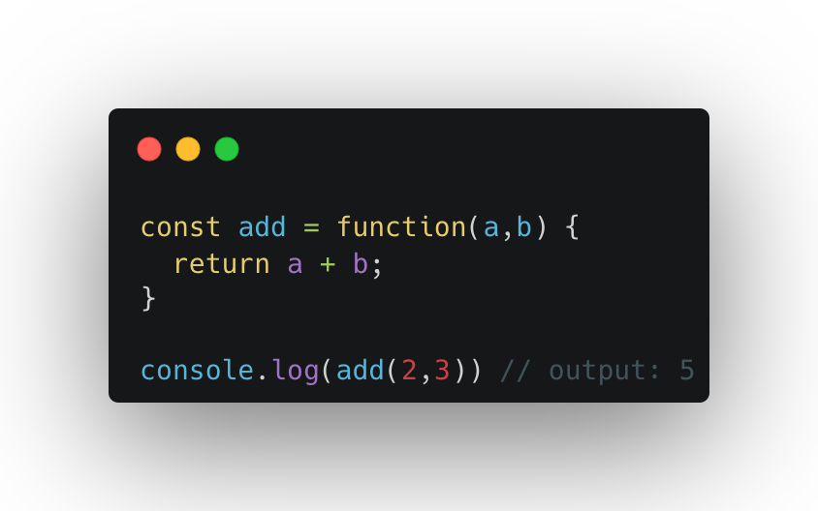
Anonymous function
Don’t have name.
Need to be tied to something: variable or an event to run

Slide 6
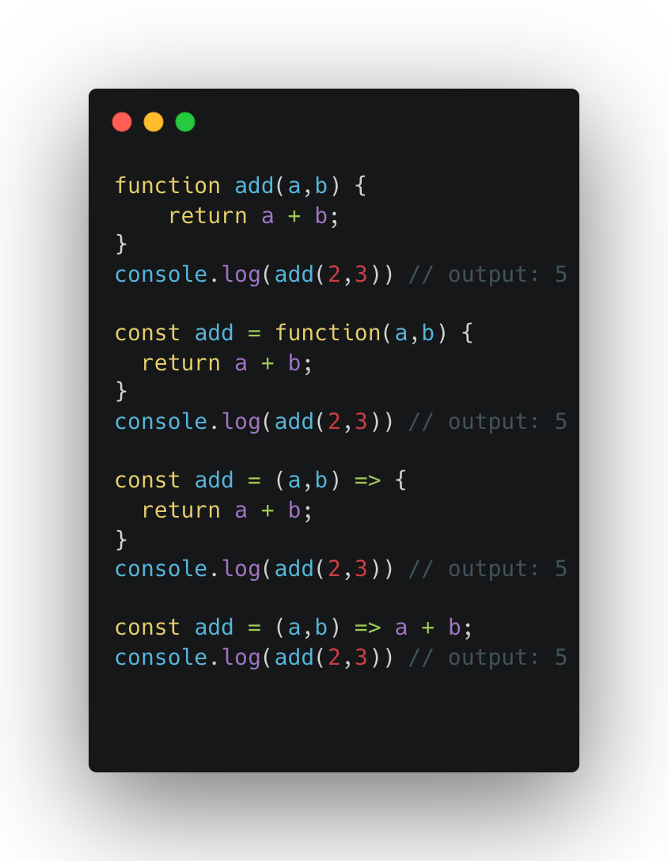
Arrow Function
In ES6, arrow function provide a shorthand syntax for defining functions.
We do not use the “function” keyword and use the arrow symbol

Slide 7
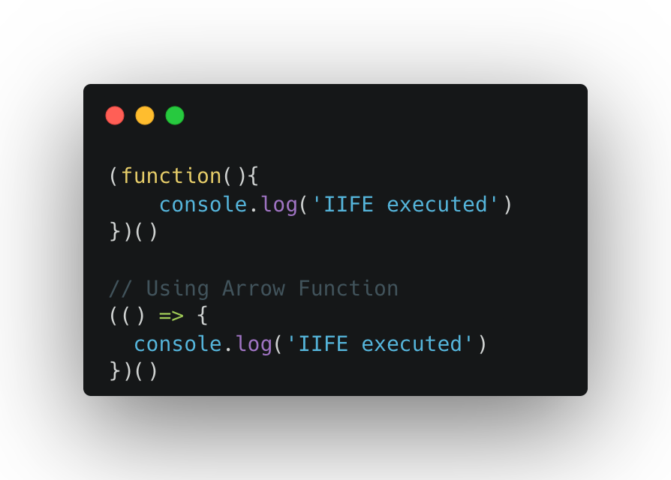
IIFE (Immediately Invoked function expression)
Executed immediately upon definition.
They help create private scopes and module patterns, preventing variables from leaking into the global scope.

Slide 8
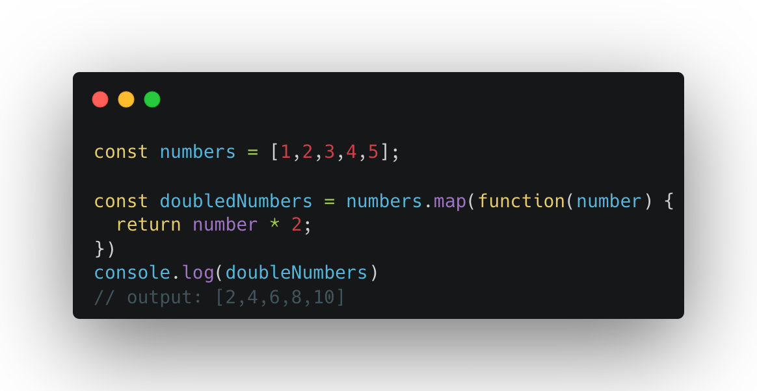
Higher-Order Functions
Functions that accept other functions as arguments or return functions.
Some example: map(), reduce(), filter() etc.

Slide 9
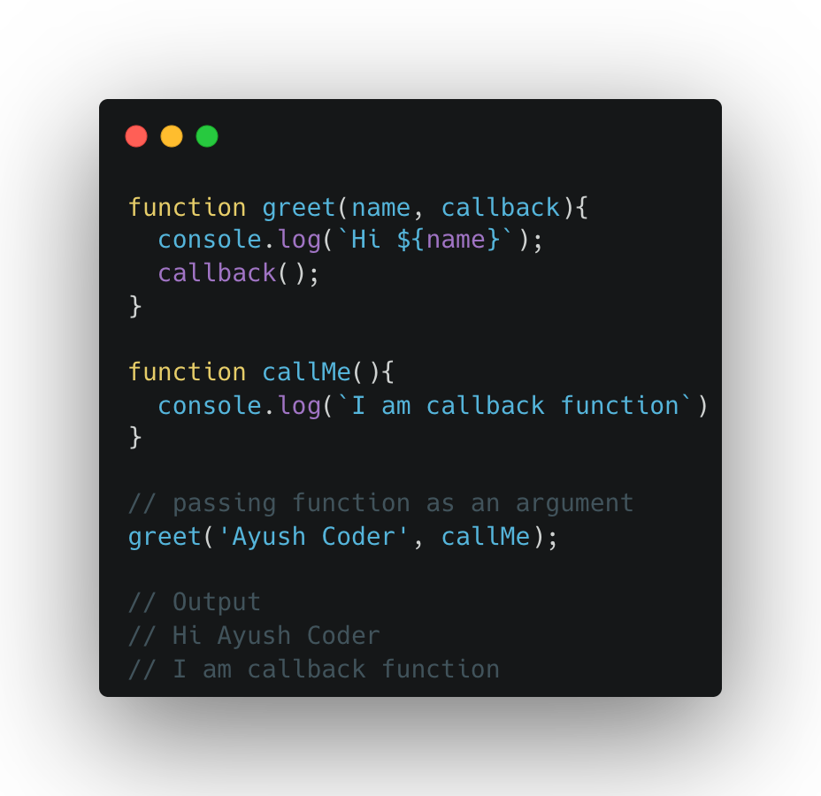
Callback function
Functions passed as arguments to other functions, commonly used in asynchronous operation.

Slide 10
Hoisting and TDZ
Notes:
Temporal Dead Zone
Think of It Like This:
var: Like putting your books on the table but not opening them.
let and const: Like keeping your books in a locker, and you can’t touch them until you unlock it.
Functions: Like having a fully prepared lunchbox you can eat at any time.
Key Points to Remember
Hoisting happens automatically in JavaScript before the code runs.
var declarations are hoisted, but their values are not.
Functions are fully hoisted, so you can use them before they are declared.
let and const are hoisted, but you can’t access them until they’re defined.
Imagine you’re getting ready for school, and you want to pack your bag. But instead of packing the books right away, your parents have already laid them out on the table for you before you even start packing. You don’t see them doing it, but when you go to pack your bag, the books are already there.
In JavaScript, hoisting works the same way.
How Hoisting Works
When JavaScript runs your code, it prepares everything before it actually starts executing. It moves (or "hoists") all the variable and function declarations to the top of the current scope. But remember, only declarations are hoisted, not the values.

Slide 11
Synchronous Function
Notes:
Synchronous Functions
Imagine you’re waiting in line at an ice cream shop. You can’t move forward until the person in front of you finishes their order. This is how synchronous functions work: one task at a time, in order.
Key Features:
Tasks are executed one after another.
The program waits for a task to finish before starting the next one.
If one task takes a long time, the entire program is delayed.
Console.log()

Slide 12
Asynchronous Function
Notes:
Now, imagine you’re at a busy fast-food restaurant where you place your order, and instead of waiting, you go sit at a table. Meanwhile, they prepare your food and call you when it’s ready. This is how asynchronous functions work: tasks can start and finish at different times without blocking the flow.
Key Features:
Tasks can run in the background.
The program doesn’t have to wait for one task to finish before starting the next.
Great for handling tasks like fetching data from a server.

Slide 13
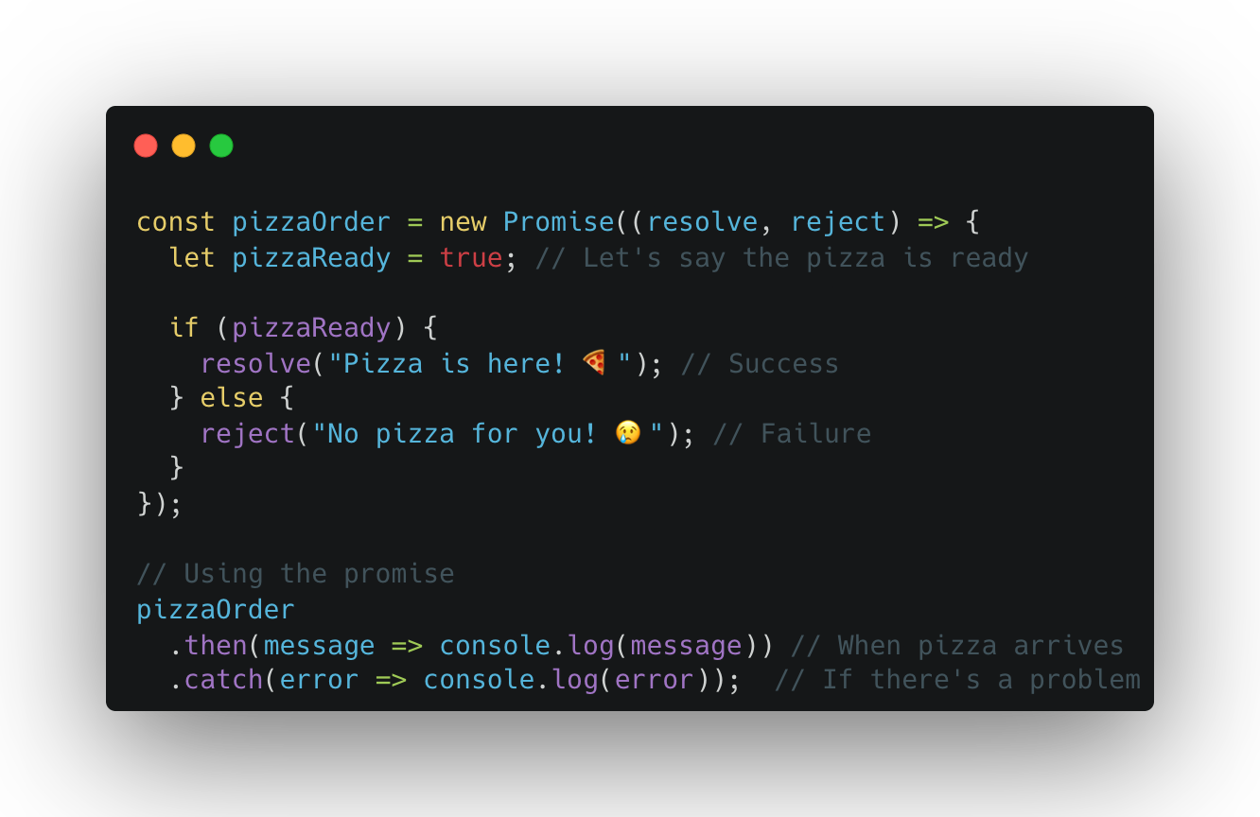
Promise
Notes:
Imagine you're ordering a pizza online. You don't stand by the oven waiting for it to cook. Instead, you go do other fun things like watching cartoons, and when the pizza is ready, the delivery guy rings your doorbell. This idea is exactly how Promises and Async-Await work in JavaScript!
What is a Promise?
A Promise is like a pizza order slip. It promises to give you a result later:
If the pizza arrives successfully, it's fulfilled (Yay! You get your pizza).
If something goes wrong, it's rejected (Oh no! The delivery guy got lost).
In JavaScript:
A Promise represents something that will be completed in the future (success or failure).

Slide 14
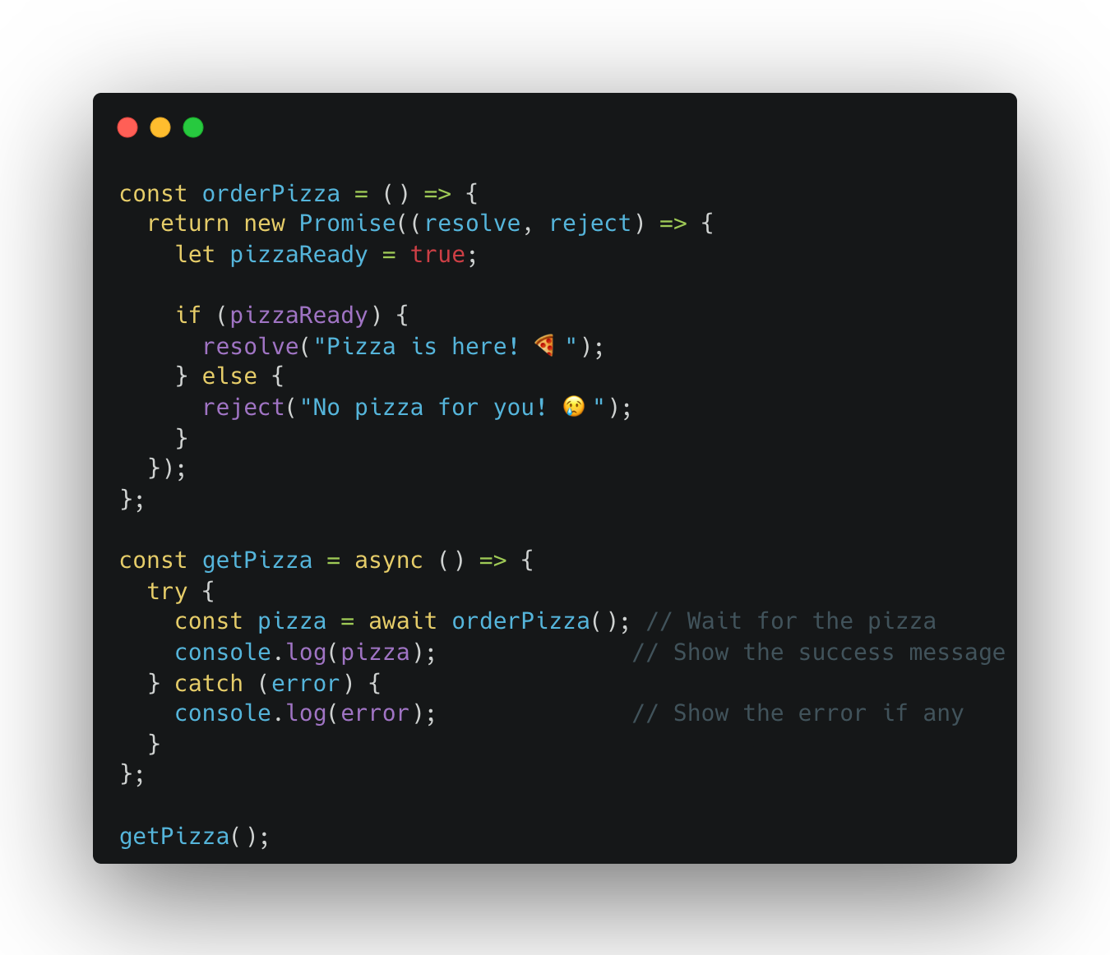
Async-Await
Notes:
With Promises, you wait for the result using .then(). But using async and await makes your code look like you're waiting for the pizza without doing the .then dance.
What is Async-Await?
async: Tells JavaScript, “Hey, this function will have to wait for something!”
await: Tells JavaScript to pause and wait for the pizza (the Promise) to be ready before moving on.
It makes your code easier to read, just like writing a story.
Why Use Promises and Async-Await?
No Waiting Around: JavaScript can keep doing other tasks (like playing your favorite game) while waiting for something to finish.
Easier to Read with Async-Await: Instead of chaining .then() and .catch(), you write clean, step-by-step instructions.
Think of It This Way:
Promise: "The pizza will arrive soon. Keep this promise slip to check."
Async-Await: "Don't worry, sit back, and wait for the pizza guy to knock."
With these tools, JavaScript can handle tasks like fetching data or waiting for something to finish, just like you wait for pizza!

Slide 15
Some built-in function (String)
split()
Trim()
toUpperCase() / toLowerCase()
Includes()
Replace()
Concat()
CharAt()

Slide 16
Feedback
What went well?
What went wrong?
What did you learn?

Slide 17
Credit
https://carbon.now.sh/

Slide 18
I believe that you learn the most if you don’t learn alone but find learning partners and other people with similar interest. - Unknown

